Slide 1

The Alliance
9th Batch
Department Of Marketing
University Of Barishal

Slide 2
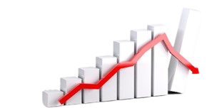
Current Economic trends in Bangladesh

Slide 3

Executive Summary
Before Covid-19, our economy was the fastest growing economy in South Asia. But since Covid Came our economy has been negatively affected like other countries economy. Growth in our economy is good but we usually give priority to some economic issues and try to develop the economy. As a result, if we do not benefit from those areas, it will have a negative impact on the entire economy. Therefore, we need to decentralize our economy.

Slide 4
Introduction:
The economy of Bangladesh is characterized as a developing market economy. It is the 35th largest in the world in nominal terms or at current prices, and the 25th largest by purchasing power parity; international dollars at current prices. It is classified among the next eleven emerging market middle-income economies and a frontier market. In the first quarter of 2019, Bangladesh was the world's seventh fastest-growing economy with a real GDP or GDP at constant prices annual growth rate of 8.3%. and Dhaka and Chattagram are the principal financial center of the country, being home to the Dhaka stock exchange and the chattagram stock exchange. The financial sector of Bangladesh is the second largest in the Indian subcontinent. Bangladesh is one of the fasted growing economies in the world and South Asia.
GDP Growth | 3.4% (2020) 6.9% (2021) 7.2% (2022) 6.0% (2023)
Inflation rate | 6.1%
Unemployment rate overall | 4.2%
GDP | $460.75 billion (nominal; 2022 est.)
GDP per capita | $2734(2022)
Foreign reserve | 44.08 billion (April 2022)

Slide 5
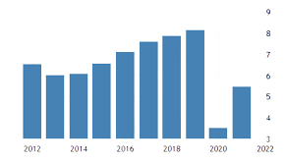
Growth saving and investment:
Growth of Gross Domestic Product (GDP) by Sectors:
Agriculture and forestry
Fishing
Mining and quarrying
Manufacturing
Electricity gas and water supply
Construction
Wholesale and retail trade
Transport storage and communication
Financial intermediations
Real estate renting and business activities
Public Administration and Defense
Education
Health and social works
Community social and personal service

Slide 6
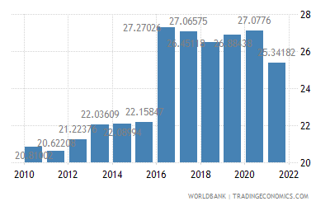
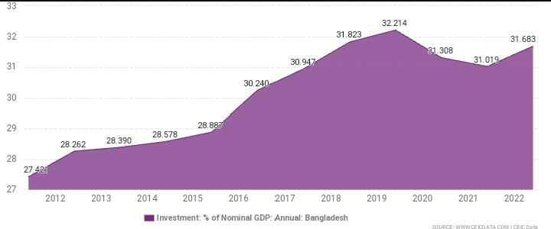
Savings: View Bangladesh's Investment: % of GDP from 1960 to 2022 in the chart:
Investment:
View Bangladesh's Investment: % of GDP from 1960 to 2022 in the chart:
Key information about Bangladesh Investment:
Bangladesh Investment accounted for 31.7 % of its Nominal GDP in Jun 2022, compared with a ratio of 31.0 % in the previous year.
Bangladesh's investment share of Nominal GDP data is updated yearly, available from June 1960 to Jun 2022, with an average ratio of 17.3 %.
The data reached an all-time high of 32.2 % in Jun 2019 and a record low of 4.7 % in Jun 1972.

Slide 7
Public Finance: Public finance is the study of the role of the government in the economy. Public Finance helps to maintain this stability and sets the economy through all the ups and downs. Tax and subsidiaries are also some of the mechanisms of public finance.
It helps to maintain and sets the economy.
Public expenditure, revenue expenditure, annual development program is part of public finance.
Public expenditure is the spending made by government of a country.
Until 19th century public expenditure was limited as laissez faire.
Revenue expenditure are short term expenditure employed in the year.
Annual development program means a document submitted along eighth annual budget.

Slide 8
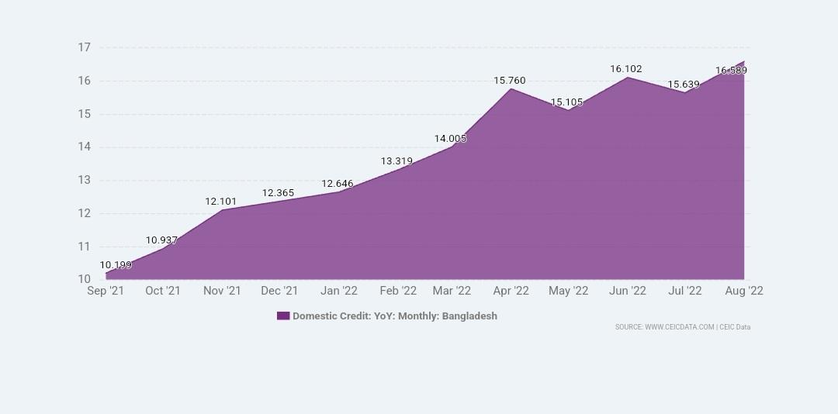
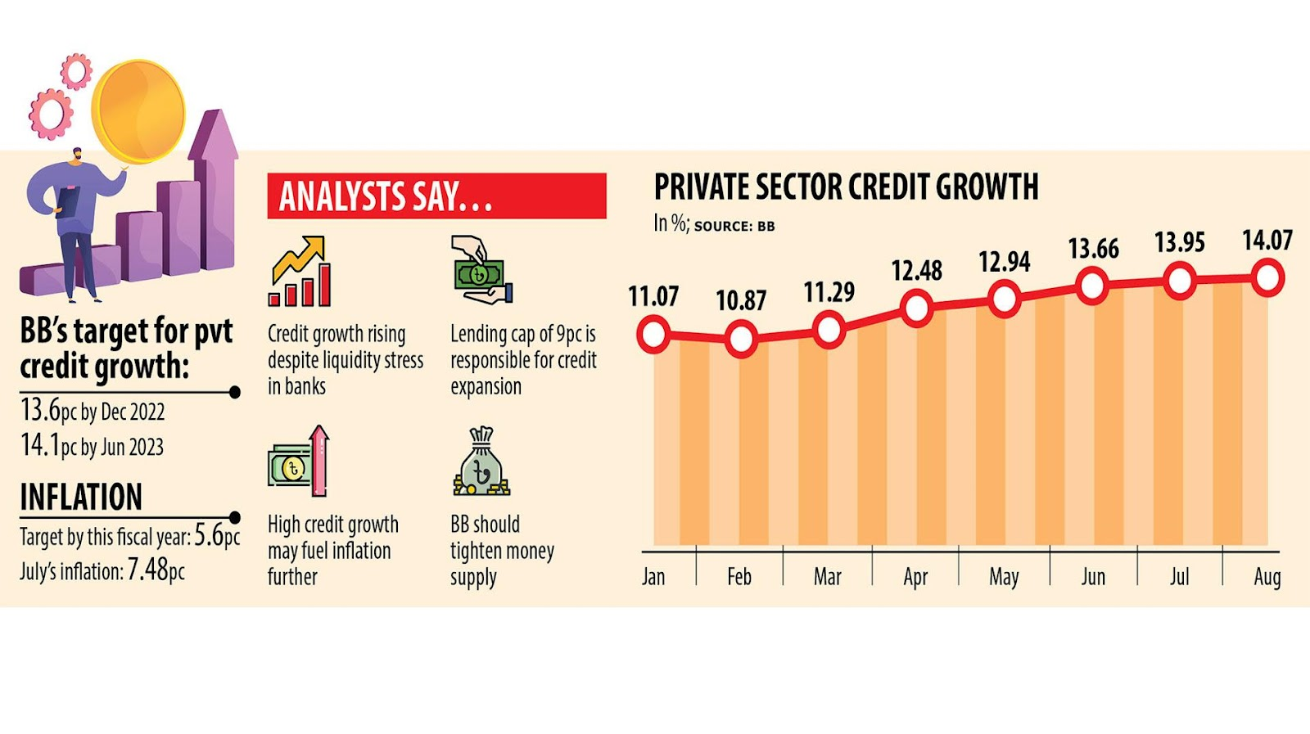
Monetary Sectors:
1. Bangladesh Domestic Credit Growth
Bangladesh Domestic Credit increased 16.6 % YoY in Aug 2022, compared with an increase of 15.6 % YoY in the previous month
It averaged 13.7 %, available from Jul 1988 to Aug 2022
View Bangladesh's Domestic Credit Growth from Jul 1988 to Aug 2022 in the chart:
2. Private Credit
Bangladesh's private sector credit growth surged to 14.07 per cent in August, almost touching the central bank's target for the entire fiscal year, an ominous sign for the economy since it may stoke inflationary pressures. In July, inflation fell to 7.48 per cent from a nine-year high of 7.56 per cent in June.

Slide 9
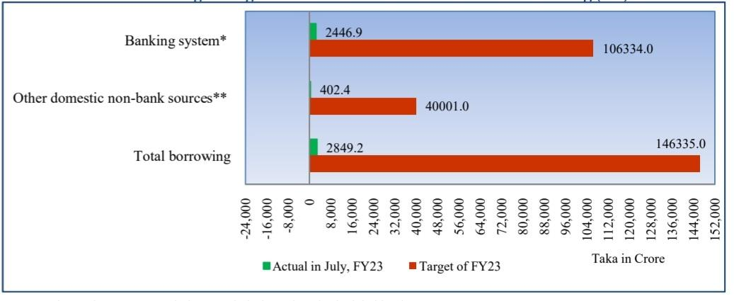
3. Government Borrowing :
Target of Government Domestic Borrowing for FY23 has been set at Tk. 1,46,335.0 crore in the national budget.
Therefore, government total net domestic borrowing both from the banking system and from the other non-banking domestic sources in July of FY23 stood at Tk. 2,849.2 crore which was 1.9 percent of the target set in the national budget. Government net domestic borrowing in July of FY22 was Tk. 12,573.3 crore which was 10.1 percent of the target set in the national budget.
Chart-1: Budget Target and Actual Government Domestic Borrowing (net)

Slide 10
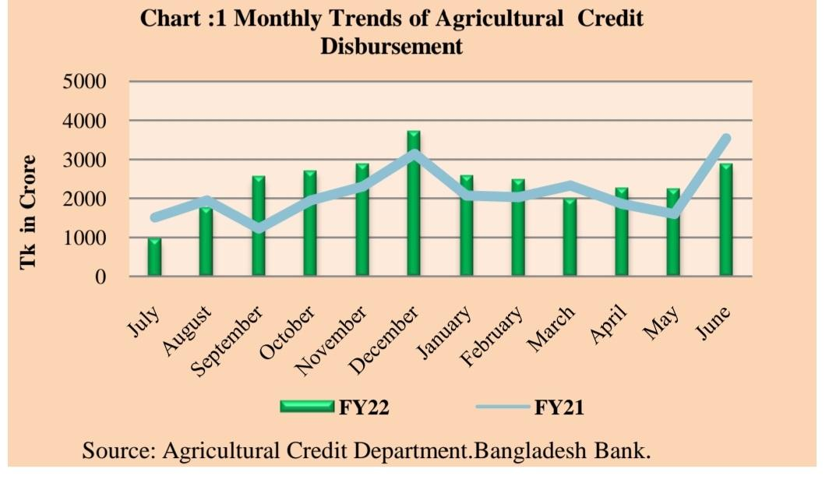
4. Agriculture Credit :
The agricultural credit disbursement target was fixed at TK 28391.00 crores for FY22, which was 7.98 percent higher than TK 26292.00 crores targeted in FY21. During FY22, total agriculture credit disbursement stood at TK 28834.21 crores, which was 101.56 percent of the total disbursement target and 13.03 percent higher than total credit disbursement of TK 25511.35 crores during FY21. Total recovery position of agricultural credit was TK 27463.41 crores during FY22, which was 1.25 percent higher than TK 27123.90 crores recovery during previous year.

Slide 11
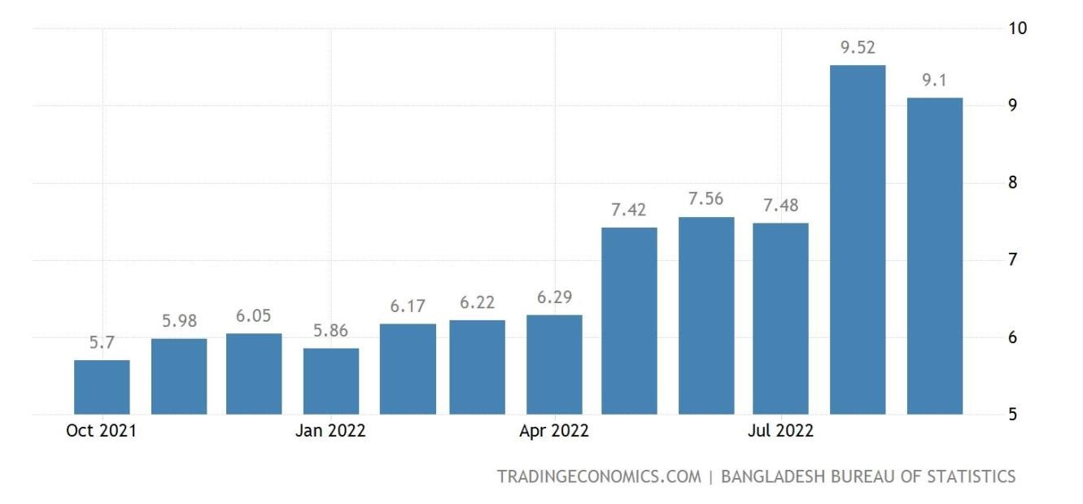
The recent inflation trends in Bangladesh:
Rising inflation in Bangladesh :
1. Since 2021 Bangladesh have been experiencing sudden and rapid surges in inflation.
2. In Bangladesh since last January the rate of increase last three moths is unbearable.
Inflation rate in Bangladesh :
The annual inflation rate in Bangladesh eased to 9.10% in September of 2022 from a near 11-year high of 9.52% in the previous month.
Monthly, consumer food prices went up 0.44 percent, easing from a 1.45 percent gain in June.

Slide 12
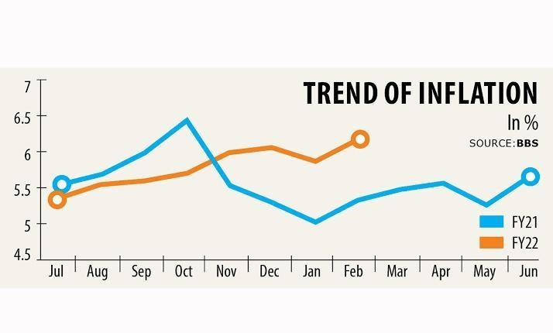
Causes of inflation in Bangladesh :
1. Increasing the supply of money
2. Due to Russia Ukraine war increase the higher cost of imported food.
3. Consumer demand already rose for Covid-19
4. Income inequality
5. Exchange rate changes
6. Increased cost of fertilizers, fossil fuel imports like petroleum and natural gas.
The trend of inflation : Here is compared two fiscal year in inflation. Fiscal year 2021 and fiscal year 2022:

Slide 13
Real Economy:
Real economy refers to all real or non - financial elements of an economy. These sectors are included with real economy:
Agriculture Sector
Industrial Sector
Service Sector
External Sector

Slide 14
Impact of Covid-19:
The covid -19 pandemic is having an adverse impact on Bangladesh's economy by affecting millions of people's life and hampering their income sources. The economic growth in the first half of 2020 has been severely affected and the economic growth projection was at -4.9% in 2022.Two and half months lockdown puts the economy in a hatted position and distorts the supply chain throughout the country. In international trade market exports have been dropped by 25.55% in 2021 compared to the last 2020.The banking sector is enjoying a modest growth in both time and demand deposits. Demand and time deposits grew by 13.70% and 11.96% in 2021.Capital markets all over the world were very resilient during the pandemic period. The trading volume in both stock exchanges increased substantially. Covid-19 also affected public finance by reducing government revenues and an increase in government expenditure to counter the pandemic.

Slide 15
Recommendation:
At present, the economy of Bangladesh is passing through a bad time. After dealing with the Corona virus, the food and other necessary things deficit has occurred due to the war between Russia and Ukraine. Which makes the situation worse in the world's developing countries. Bangladesh is a developing country. So, it is affected greatly. Among them, these problems are affecting in some ways:
Most of the people of the country are becoming unemployed.
Production in the agricultural field is reduced and Bangladesh is forced to increase imports.
Due to the reduction of exports, there is a serious effect on the country&amp;apos;s reserve money. For this, the shortage of foreign exchange reserves badly hampers our economy (foreign exchange reserves declined, reaching US$ 38.9 billion by the end of August 2022).
Power generation is disrupted due to the lack of a proper supply of fuel and due to the excess price of the fuel.

Slide 16
Moreover, human development outcomes improved along many dimensions. Addressing infrastructure gaps would accelerate growth. Pivoting towards green growth would support the sustainability of development outcomes for the next generation.
Bangladesh can bring its economic stability back using some strategies. these are given below:
Create jobs and employment opportunities through a competitive business environment, increase human capital and build a skilled labor force, build efficient infrastructure, and establish a policy environment that attracts private investment.
Explore some of Bangladesh&amp;apos;sresources such as oil, coal, gas, and other energies.
Increase some new organizations where unemployed people get benefitted by doing work.
An increased remittance income can consists of strong stability of the economy.

Slide 17
Conclusion:
We have tried to discuss the ongoing economic trends of Bangladesh and to give an idea of ​​the economy of Bangladesh. We think we have succeeded in doing so. When we conduct surveys we observe the problem and prospects of our economy. We believe that we need to take our ongoing economic problems as challenges and exploit the possibilities to make our economy more dynamic.

Slide 18
That’s All
Thank you Sir

